Slide 1
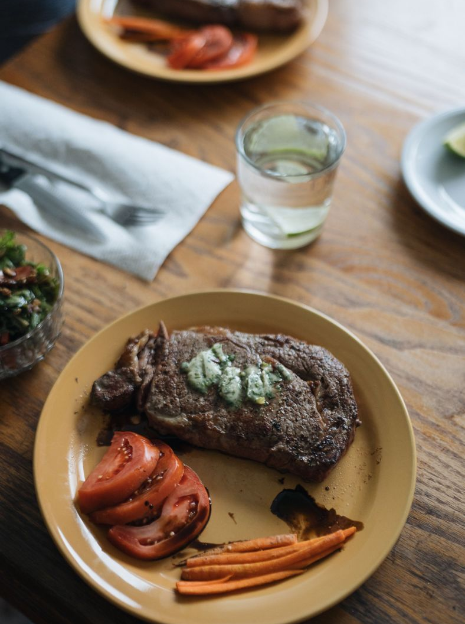
QUARTERLY CLIENT TASTING DINNER
An Evening of
Napa and Piedmont
Saturday, November 14, 2026
The Atkins home, 1480 Vineyard View Lane, Yountville

Slide 2
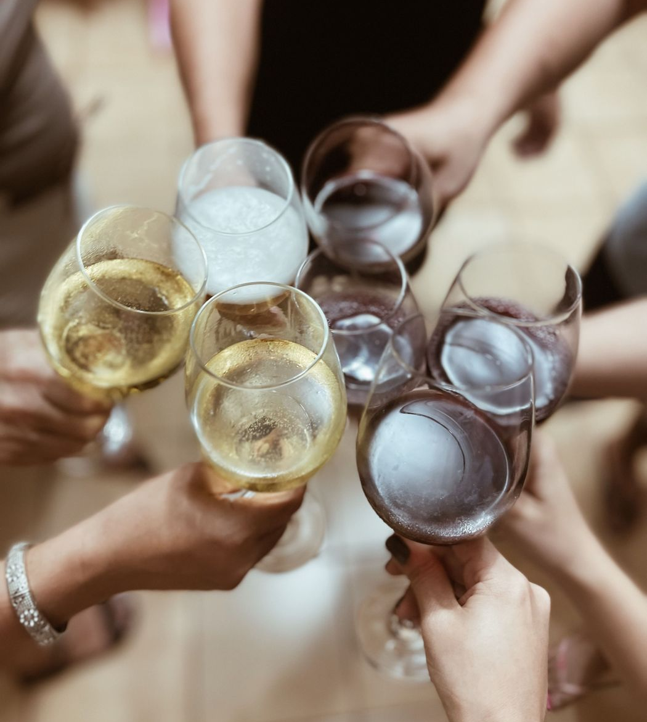
The Evening
A first look at the Italian program. Napa anchors are paired against the incoming Piedmont samples, so guests taste the direction the portfolio is heading. Robert handles the room and decor. Twelve to sixteen top accounts at one long table, the way these evenings sell a list better than any sheet.
Reception grower Champagne. Canapes kept light, no heavy cream or aged cheese.

Slide 3
Menu and Pairings
Course | Dish | Pairing
Reception | Passed bites | Grower Champagne, Brut
First | Butternut squash veloute | Stonecreek Chardonnay 2023
Second | Wild mushroom risotto | Marchetti Langhe Nebbiolo
Main | Braised short rib | Whitfield Reserve Cabernet 2021
Vegetarian | Roasted eggplant | Whitfield Reserve Cabernet 2021
Dessert | Apple tart | Vintage Port

Slide 4
From the Cellar
Private collection
About 400 bottles in the home cellar, insured at 85,000 dollars under the Hartford policy. Held at 55 degrees and 70 percent humidity. Tonight pours the Napa verticals beside the first Piedmont samples.

Slide 5
Guests and Pours
David Kim of Le Jardin Dore leads the table. Susan Bradley handles invitations and the final count. Eric Hoffman delivers from the warehouse the day before.

Slide 6
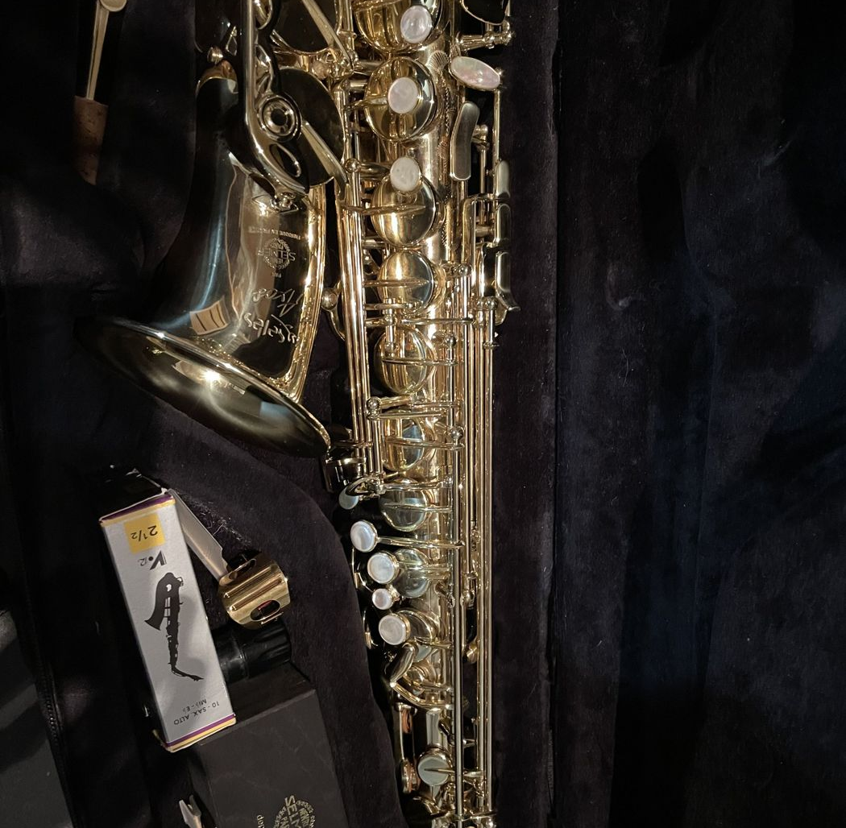
Run Sheet
Time | Action
3:00 PM | Catering staff arrive
5:00 PM | Glassware set, wines decanted
6:30 PM | Guests arrive, reception
7:15 PM | Seated dinner and pairings
9:30 PM | Port, coffee, and close
Budget target 4,500 dollars, settled from the marketing line.

